Slide 1


London Weather Prediction using Apache Spark
Course:
CSYE 7200: Big-data engineering Using SCALA
Professor:
Robin Hillyard
Team 9 :
Renteng Huang, ShuangShuang Xu, Balaji Mudaliyar

Slide 2


Goals of the project
To predict the future weather condition of London city.
To develop Apache - Spark Scala code to clean, train, model the data.
To use Apache - Spark Scala MLlib(Machine Learning Library) to predict the weather.
We will be implementing the UI using play framework.
Collaborative learning and knowledge sharing
Delivering each milestone on time

Slide 3
Use cases
Model input
Date
Model Output
Temperature, Pressure

Slide 4
Use cases
Model input
Date, Mean Humidity, Mean Pressure
Model Output
Weather(Sunny or Rainy)

Slide 5
Methodology
The cleaning of the training dataset
Fitting of the data to the model.(Linear Regression)
Making predictions based on fitted model
Calculating accuracy of the model
Save predictions
Data
Cleaning and Aggregating
Fitting/Training the data to the model
Make predictions based on the fitted model
Save predictions and test accuracy of the model
Training
Dataset
Predictions

Slide 6
Machine Learning Algorithm

Slide 7
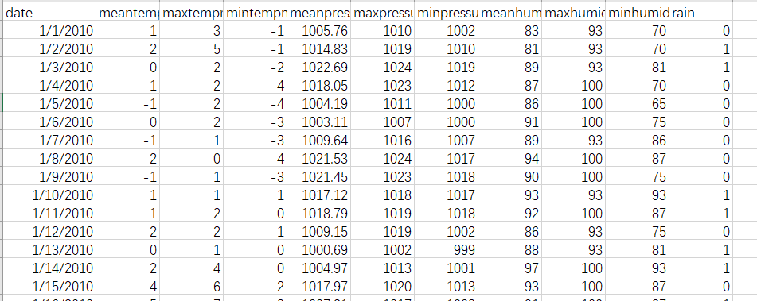
Data source
Weather Underground : (http://api.wunderground.com/api/API_KEY/history_DATA/q/UK/London.json)
Using python to get the data which we want to get
3700 record dataset containing weather information of London city

Slide 8
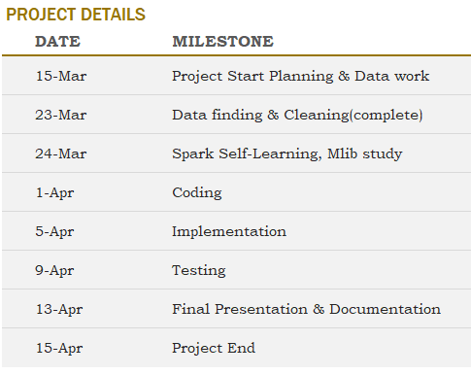
Milestones/sprints

Slide 9
Programming in Scala and code repository
Most part of the project will be programmed in Scala including
Cleaning
Splitting(Training& Testing)
Fitting/Training Data to Model
Predictions
Accuracy Calculation
Code repository : GitHub
https://github.com/001239511ShuangShuangXu/csye7200-spring2018-group9

Slide 10
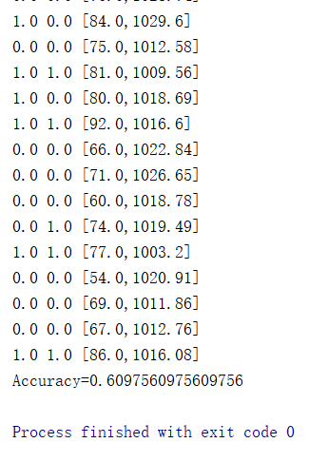
Accuracy
Accuracy of average weather condition in a week

Slide 11
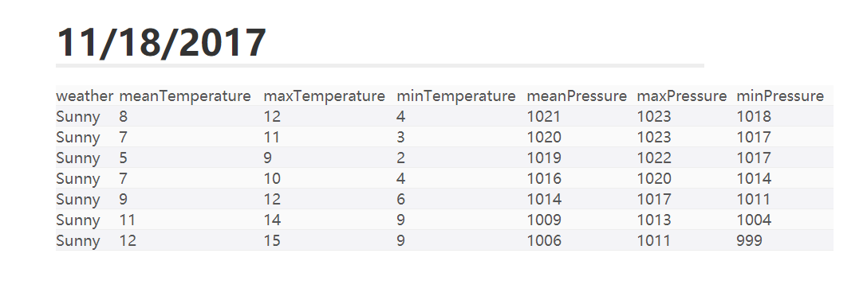
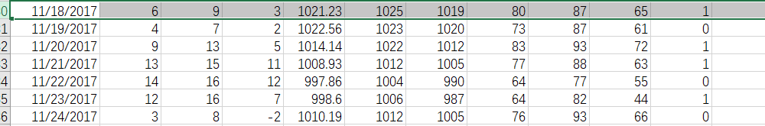
Accuracy

Slide 12
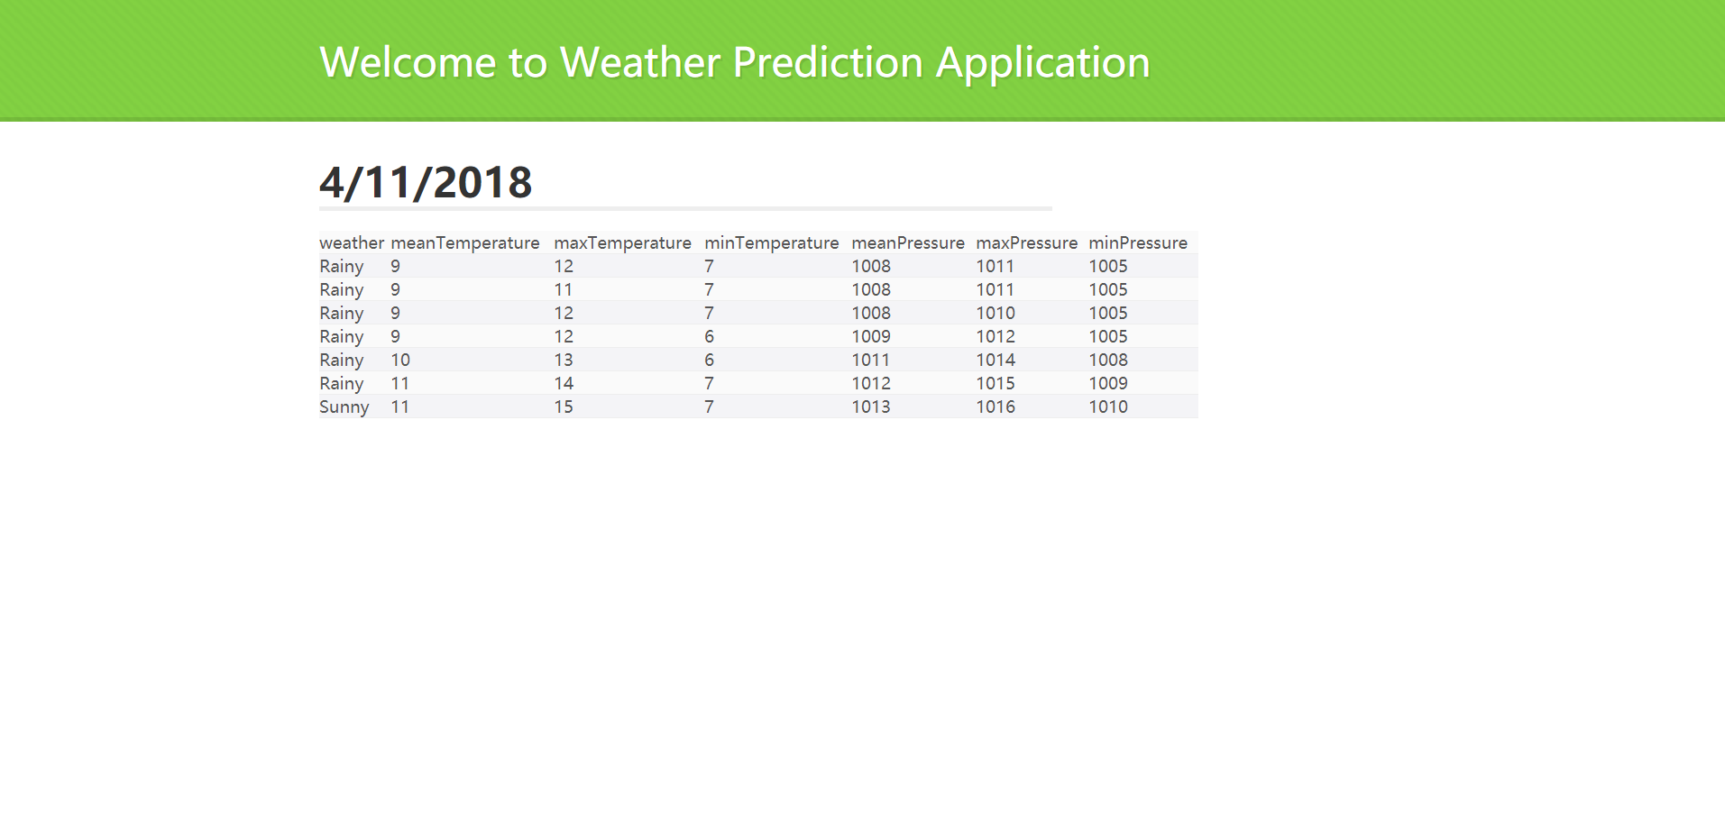
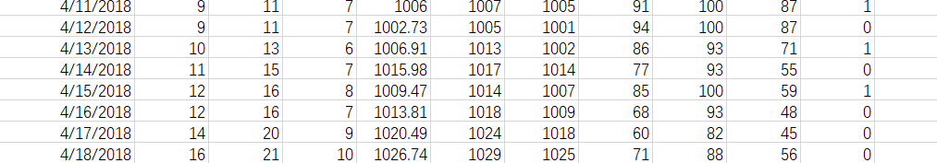
Accuracy

Slide 13
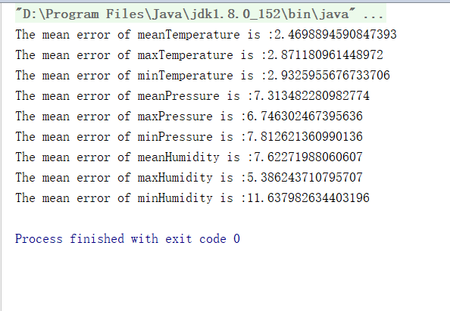
Root Mean Square Error

Slide 14
Acceptance criteria
We had a target of 4/7(day/day) accuracy. We ended up having model with 61% accuracy.
We had Targeted a Root Mean Square Error (RMSPE) of 20 but we ended up achieving a RMSE of 3 for temperature and 7 for pressure.

Slide 15

End

